Slide 1
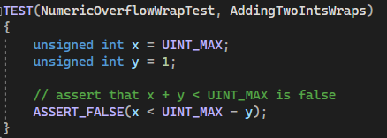

Unit Test - AddingTwoIntsWraps
Notes:
For our first negative unit test, we’ll test to ensure that adding two integers will result in integer wrapping. We initialize x to the unsigned integer max and y to one. Then we assert that adding these two integers will result in wrapping by using a precondition check that x is less than the difference between the unsigned integer max and y.

Slide 2
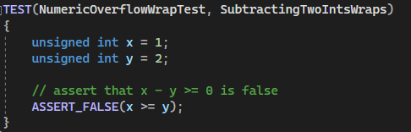
Unit Test - SubtractingTwoIntsWraps
Notes:
For our second negative unit test, we’ll test to ensure that subtracting an integer from a smaller integer will result in integer wrapping. This boils down to a simple test case where we assert that x, the smaller number, is not greater than or equal to y.

Slide 3
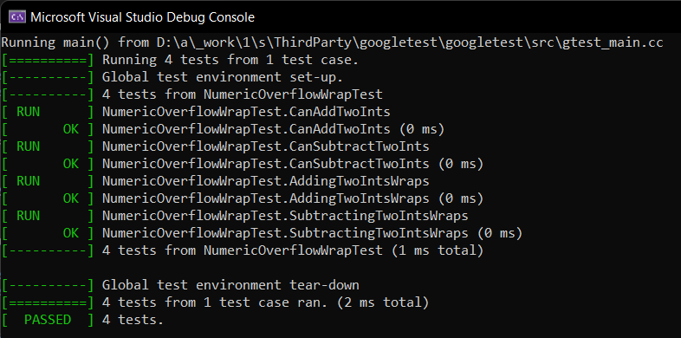
Unit Test - Results
Notes:
And here we can see that all unit tests have passed.

Slide 4


AUTOMATION SUMMARY
Notes:
The DevSecOps pipeline is the normal DevOps pipeline with security integrated into it. There are two sides to the DevSecOps pipeline: Pre-production and Production. In Pre-production you move through the following phases: assess and plan, design, build, and then verify and testing. Once the application has been deployed, we then move into the Production side of the pipeline. Here we move through the transition and health check phase, and into the monitor and detect phase. When an attack is detected, we move into the respond phase (either manually or automatically). Once the attack has been thwarted, we transition to the maintain and stabilize phase where we assess what happened and how we can prevent it in the future. We then use those finding and move back into the pre-production assess and plan phase. As we can see, security and automation tools should be present throughout the DevOps process for it to truly be DevSecOps.

Slide 5
TOOLS
Pre-Production
Design
OWASP dependency checker
Test driven development (TDD)
Build
Static analysis tools such as CppCheck and the IDE compiler
Verify and Test
Unit tests and automated integration tests
Production
Transition and Health Check
Automatically deploy security/config settings
Automatic network and penetration tests
Monitor and Detect
Listen for attacks, notify, & trigger auto response
Respond
Automatically block attack, turn off services, roll back to stable release
Notes:
Therefore, it makes sense to automate as much security enforcement and compliance in the DevOps pipeline as possible. With regards to automation tools, some areas of the DevOps pipeline can be automated. On the pre-production side, parts of design phase can be automated by utilizing the OWASP dependency checker. This will list all known vulnerabilities of each dependency in your design. Test driven development is also an important part of the design phase. In the build phase, static analysis tools should be used in the developer’s IDE and the compiler flags for errors and warnings should be set to their highest level. This will help developers catch common errors and warnings in their code that could lead to a security vulnerability. In the verify and test phase, automated unit and integration tests should be performed before the modified codebase is released to production. Developers will write their own unit tests and ensure they pass all tests before committing their code. Integration tests will likely be done during off hours, typically at night.
On the production side, more automatic security tests should be performed in the transition and health check phase. Specifically, security and configuration settings should be automatically deployed. Automatic network and penetration testing should also be continuously performed. During the monitor and detect phase, logs should be collected from all areas and automatically analyzed. If a threat is detected, it should trigger an automatic response. This leads into the response phase, where some threat is detected automatically, it should trigger either a notification to the appropriate team(s) for action or trigger some automatic defenses. These automatic defenses could be blocking the attacks, turning off certain services, or rolling back a new release to an older, more stable, version.

Slide 6
RISKS AND BENEFITS
Social Engineering / Phishing
Phishing attacks increased by 11% in 2021 (Verizon, 2021)
85% of all breaches involved end user error (Verizon, 2021)
Phishing attacks caused over $2.1 billion in lost revenue in 2020 (Abnormal Security, 2021)
Denial of Service (DoS) / Direct Denial of Service (DDoS)
Can result in millions of dollars in lost revenue (Nicholson, 2022)
AWS experience a DDoS attack in 2020, peaking at 2.3 Tbps (Nicholson, 2022)
Notes:
While our security policy is comprehensive, there is always room for improvement. Some common cyber attacks that could be exploited, even with our security policy, are social engineering/phishing and denial of service and direct denial of service attacks.
In 2021, phishing attacks increased by 11 percent and 85 percent of all breaches involved end user error. The Colonial Pipeline ransomware attack in 2021 was likely due to successful phishing campaign. Per the FBI, phishing was responsible for over 2.1 billion dollars in lost revenue in 2020 – the most of any security threat. Protecting against these attacks should be a top priority to prevent security breaches and lost revenue.
Another cyber-attack is a denial of service or direct denial of service attacks. These attacks can interrupt an organization’s services, causing several hours of downtime until the attack subsides or security professionals defend against it. Even a couple hours of downtime can result millions of dollars of lost revenue. They can also be used to distract security professionals while other, less noticeable, cyber-attacks exploit other targets. One of the largest DDoS attacks occurred in 2020 when AWS was hit with a massive DDoS attack, peaking at 2.3 terabytes per second. While AWS successfully defended against the attack, the lost revenue that could have resulted from downtime from the largest cloud provider would be astronomical.

Slide 7
RECOMMENDATIONS
Phishing
Biannual email phishing trainings
Implement “Report Phishing” tool in email client
DoS / DDoS
Optimize server configurations
Explicitly define responses and what resources can be used
Sanitize web traffic
Over-provision severs
Cloud Security
Cloud vulnerabilities increased by 150% in the last 5 years (Embroker, 2022)
90% of all breaches caused by web app breaches (Verizon, 2021)
Notes:
Clearly, there are some gaps in our security policy, and we should look to defend against cyberattacks such as phishing and denial of service.
A thorough security policy requires everyone to be involved. From the developer and designer down to the end user. Defending against phishing attacks will requires this mindset. We should implement biannual trainings to educate everyone in the organization, so they are aware of phishing attempts and how to recognize them. We should also implement a “report phishing” tool in our email client, so that employees can report suspicious emails to our security team and they can take appropriate action.
Defending against DDoS attacks requires a multifaceted approach. Servers should be configured optimally by explicitly defining what resources an application can use and how it responds to client requests. Servers can also be provisioned in a way to sanitize traffic, dumping DDoS traffic into a network black hole or by using load balancing, before forwarding legitimate traffic along. This doesn’t always work however, as some legitimate traffic will always be lost. Another approach is to over-provision servers. This can be easily done if using a cloud provider as you can provision additional servers on-demand.
Speaking of cloud providers, we should also include more emphasis on cloud security in our policy. In the last five years cloud vulnerabilities have increased by 150 percent. In another report, 90% of all breaches analyzed were caused by web application breaches.

Slide 8
CONCLUSIONS
Bad actors will continue to exploit new vulnerabilities
A different approach – Find and exploit vulnerabilities before they do!
Bug bounty program
Reward people for identifying and reporting bugs
Contract white-hat security auditors
Ethical hackers work to exploit vulnerabilities and report them back
Security is everyone’s responsibility
Notes:
In all, this security policy has some gaps that need to address now. However, as bad actors continue to use more sophisticated attacks, our security policy should continually change and update to defend against these attacks. Another way to combat future attacks is to identify exploits before bad actor do. By implementing bug bounty programs and/or employing white-hat security auditors, with the intent on purposely gaining unauthorized access to a system, we can identify vulnerabilities and address them before they can be exploited.
In the end, the one idea that will continue to be the center of our security policy is that security is everyone’s responsibility.

Slide 9
REFERENCES
Abnormal Security. (2021, May 13). Colonial Pipeline Attack: Phishing Email Likely the Culprit. Abnormal. Retrieved October 16, 2022, from https://abnormalsecurity.com/blog/colonial-pipeline-attack-phishing-email-likely-the-culprit
Embroker. (2022, October 13). Top 10 Cybersecurity Threats in 2022. Retrieved October 16, 2022, from https://www.embroker.com/blog/top-10-cybersecurity-threats-2022/
Nicholson, P. (2022, May 12). Five Most Famous DDoS Attacks and Then Some. A10 Networks. Retrieved October 17, 2022, from https://www.a10networks.com/blog/5-most-famous-ddos-attacks/
Verizon. (2021, May 20). Cybercrime thrives during pandemic: Verizon 2021 Data Breach Investigations Report. Retrieved October 16, 2022, from https://www.verizon.com/about/news/verizon-2021-data-breach-investigations-report

